Slide 1
Magic Money Manage
Smart expense analyzer.
An Intelligent NLP + ML Powered Personal Finance Tool.

Slide 2
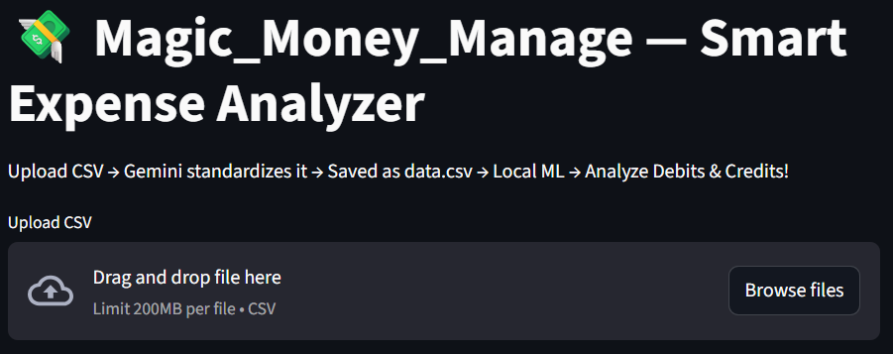
Initial Appearance of the Project
•This stage gives the short description about the goal of the project and the work flow (Upload CSV → Gemini standardizes it → Saved as data.csv → Local ML → Analyze Debits & Credits). • It even also ask to upload CSV file for input.

Slide 3
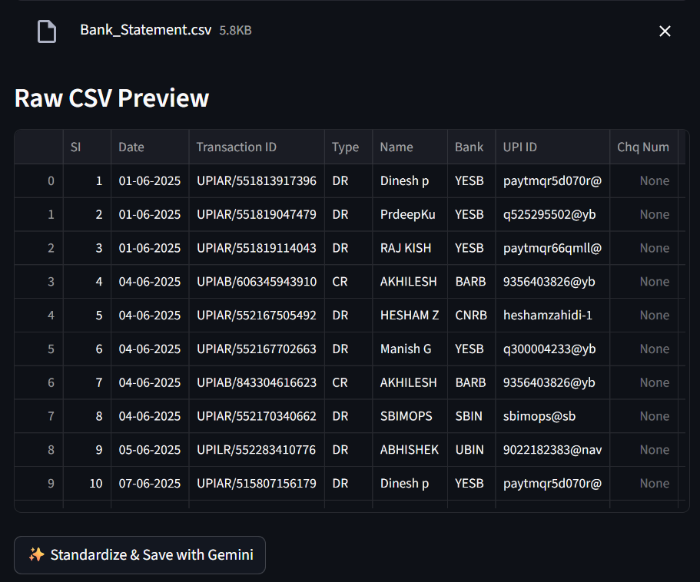

Slide 4
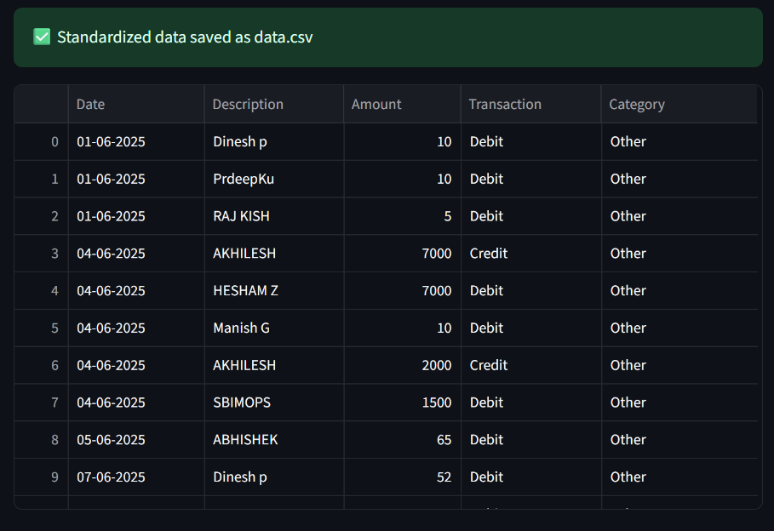


Slide 5
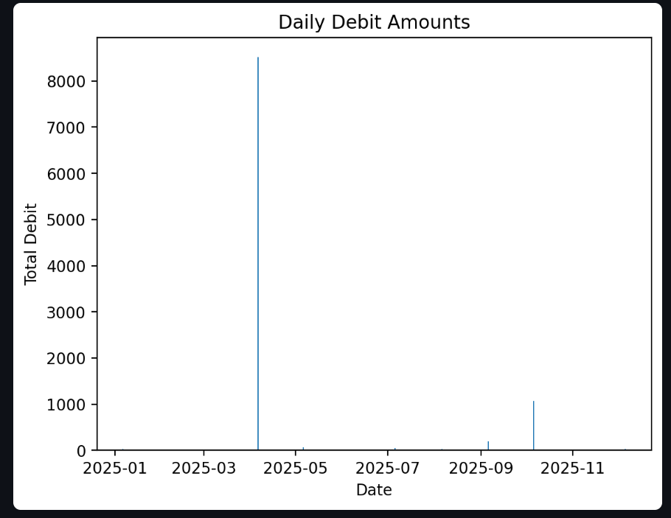


Slide 6
